Slide 1

Application to the Management of Logistics System
BY
Rohan N - 20171CSE0579
Brunda H Y - 20171CSE0140
Ranjan Shetty - 20171CSE0569
Sunil Reddy - 20171CSE9022
Varshini Sadanand J S - 20171CSE9017
Guided By
Ms. Manasa C M
Assistant Professor,
Department of Computer Science and Engineering,
Presidency University, Bangalore

Slide 2
Agenda
Introduction
Project Overview
Literature Survey
Objectives
Design
H/w and S/w Components
Conclusion
Project Outcome
References in IEEE format

Slide 3





Introduction
Android Application Development or Mobile App Development is the process of creating software applications that run on a mobile device, and a typical mobile application utilizes a network connection to work with remote computing resources.
Fundamentals of Android Development:
  Activities
  Services
  Content providers
  Broadcast receivers

Slide 4
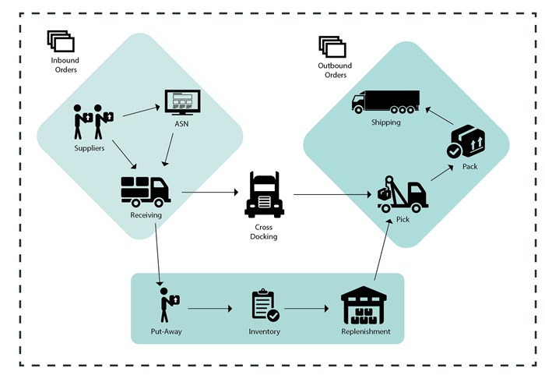
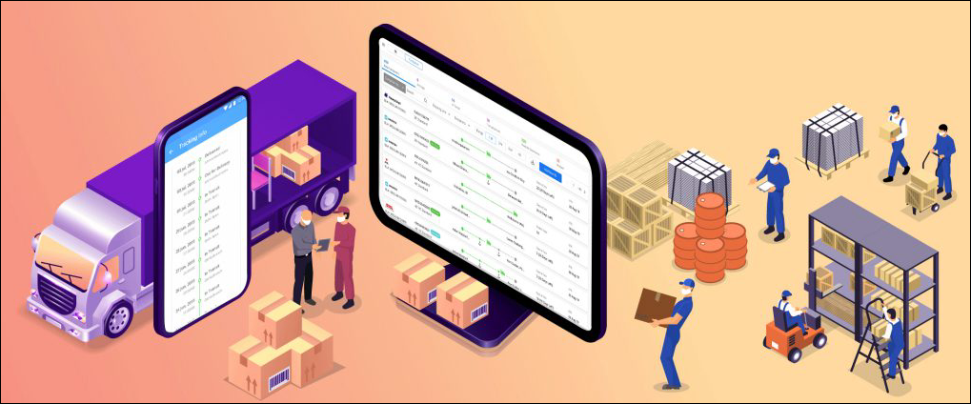
Introduction
The Logistics drive business globally. Logistics is one of the most important and complex part of any business.
Logistics can manage the transportation of the goods and materials and involve various processes including ,
  warehousing,
  material handling,
  supply chain management and the like.

Slide 5


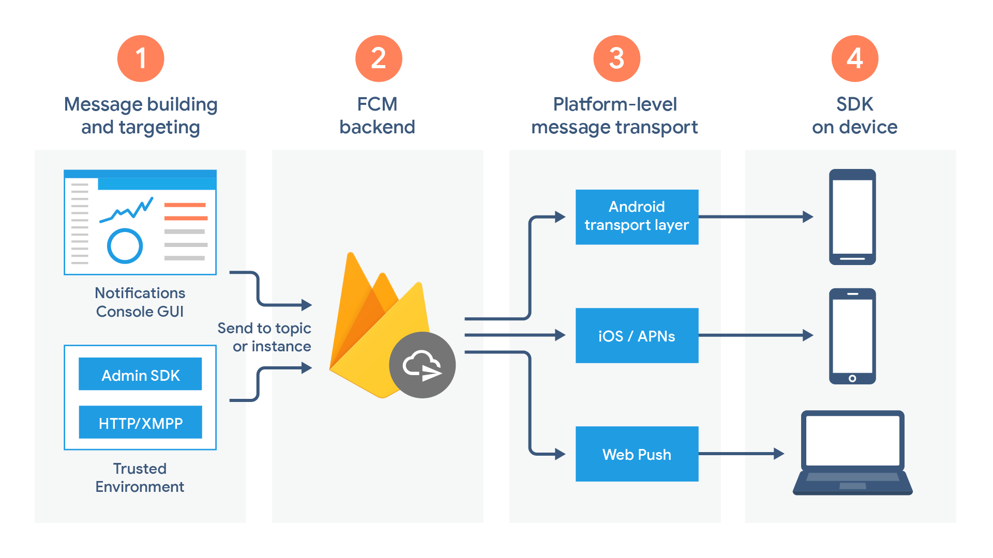
Introduction to Firebase
Firebase is the Real-time Backend for an application. It provides –
  Real-time database
  Authentication
  Cloud Messaging
  Storage
  Hosting
  Remote Configuration
  Test Lab
  Crash Reporting

Slide 6

Adobe Xd
Adobe Xd was used to design the user interface for our Application.

Slide 7
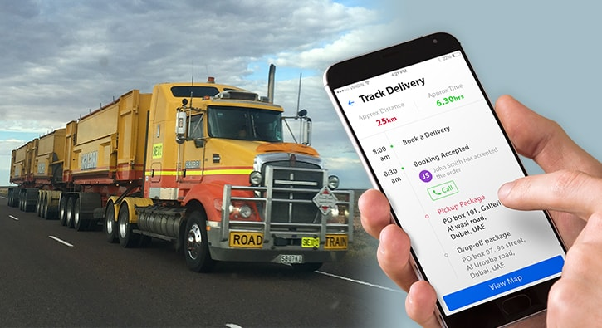
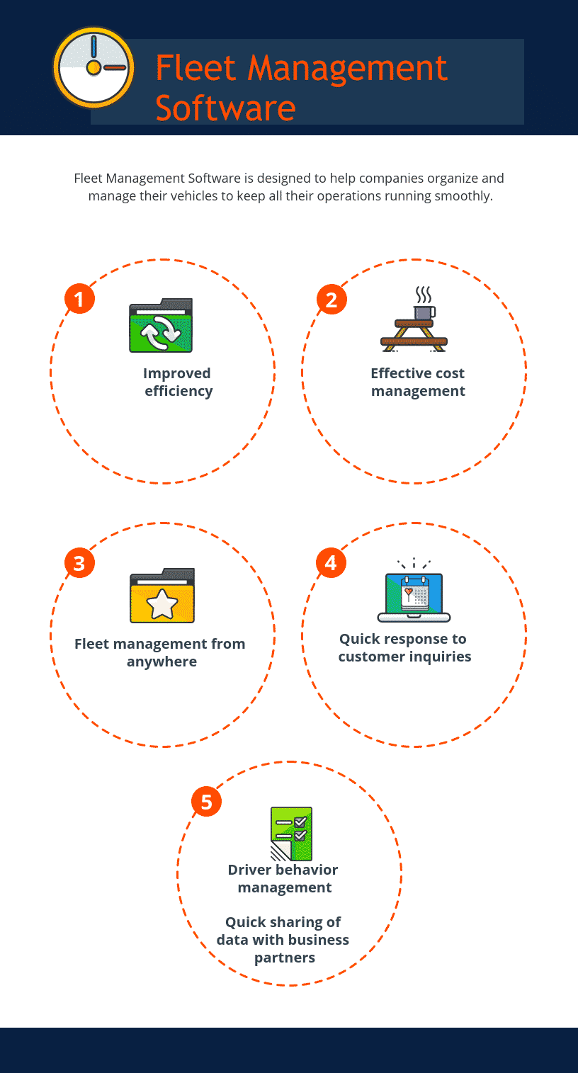
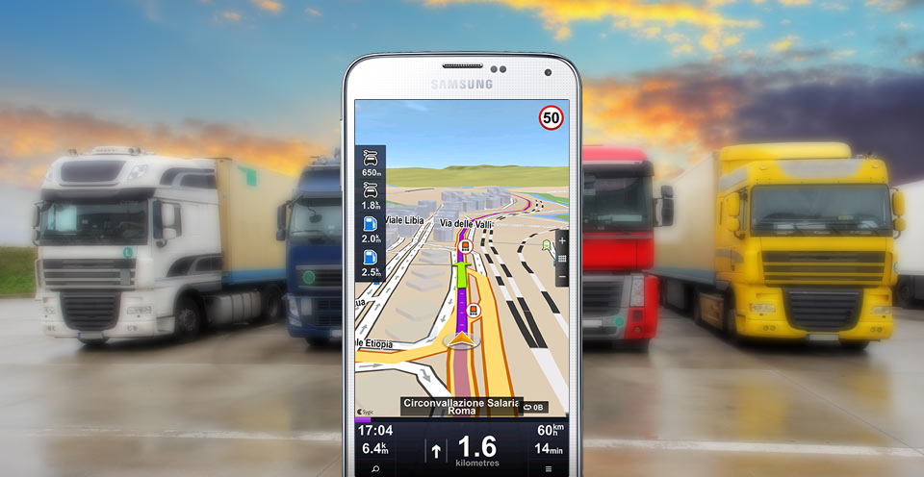
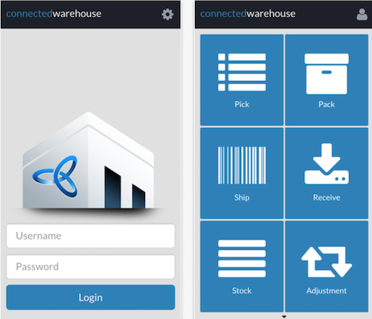
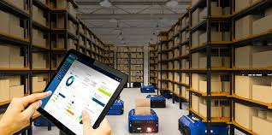
Motivation
Logistics management System needed the following logistics and transportation app solutions:
Apps to manage fleet
Apps for warehouse
Apps for tracking

Slide 8
Literature Survey
Ref No | Paper Title | Author Names | Journal Name, Publisher and Year | Technique Used
1. | A social network analysis of business Logistics and transportation | Philips, D.M. and Philips, J.K. | International Journal of Physical Distribution and Logistics Management. (1998) | Report
2. | Developing an E-Logistics System: A Case Study | Prof. Angappa Gunasekaran | International Journal of Logistics Systems and Management | Case Study
3. | The integrated logistics management system: a framework and case study | Huan Neng Chiu | National Taiwan Institute of Technology, Taipei, Taiwan, Republic of China | Framework and case study
4. | Proceedings Digitalization in Supply Chain Management and Logistics: Smart and Digital Solutions for an Industry 4.0 Environment | Kersten, Wolfgang (Ed.); Blecker, Thorsten (Ed.); Ringle, Christian M. (Ed.) | Kersten, Wolfgang (Ed.); Blecker, Thorsten (Ed.); Ringle, Christian M. (Ed.) | Report

Slide 9
Literature Survey
Ref No | Paper Title | Author Names | Journal Name, Publisher and Year | Technique Used
5. | The impact of the logistics management in customer satisfaction | Amine GHOUMRASSI and Gabriela ȚIGU The Bucharest University of Economics studies, Bucharest, Romania | Proceedings of the 11th International Conference on Business Excellence 2017 | Research Paper
6. | Analysis of the Logistics Research in India – White Paper | C. Thallera , N. Moraitakisb , H. Rogersc , D. Sigged , U. Clausena , H.-C. Pfohlb , E. Hartmannc , B. Hellingrathd | the German Federal Ministry of Education and Research (BMBF) | Research Paper
7. | Logistics Management Research Collaboration in Asia | Yenchun Jim Wu, National Taiwan Normal University. Chih-Hung Yuan, University of Electronic Science and Technology of China, Zhongshan Institute | The International Journal of Logistics Management · January 2017 | Content analysis , followed by social network analysis which is applied on the selected articles to provide a structure of the collaboration relationship

Slide 10
Project Objective
The Proposed project objective is as follows
Achieve successful management of logistics that is concerned with getting,
the right product
in the right quantity
in the right condition
at the right place
at the right time
to the right customer and
at the right price.

Slide 11
Proposed System Design
The three panels are: Admin, Customer and Driver Panels.
1. Admin Panel contains the following features:
1. Login
2. Add Trucks
3. Add Drivers
4. View Truck Location Updates
2. Driver Panel contains the following features:
1. Login
2. View Booking Details
3. Update Location

Slide 12
Proposed System Design
3. Customer Panel contains the following features:
1. Registration
2. Login
3. View Trucks
4. Book Trucks
5. Location Update

Slide 13
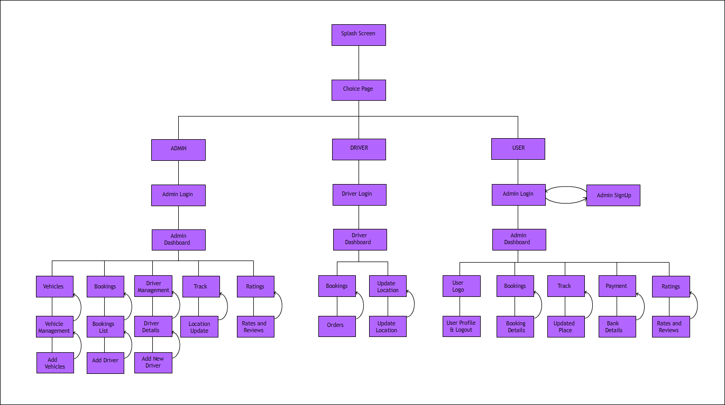
Architecture Diagram

Slide 14
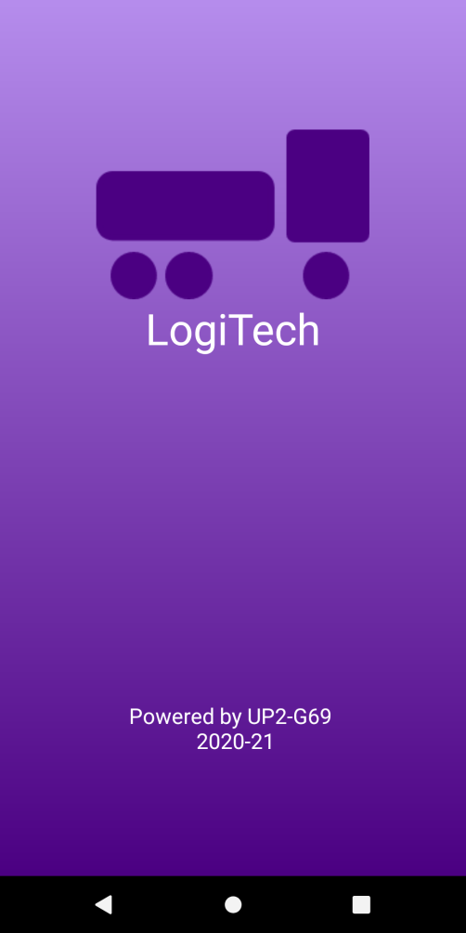
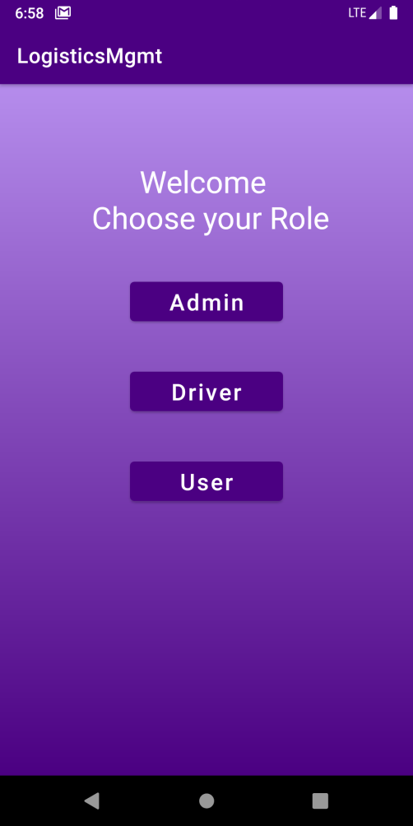
1. Home
Splash Screen
Choice Page

Slide 15
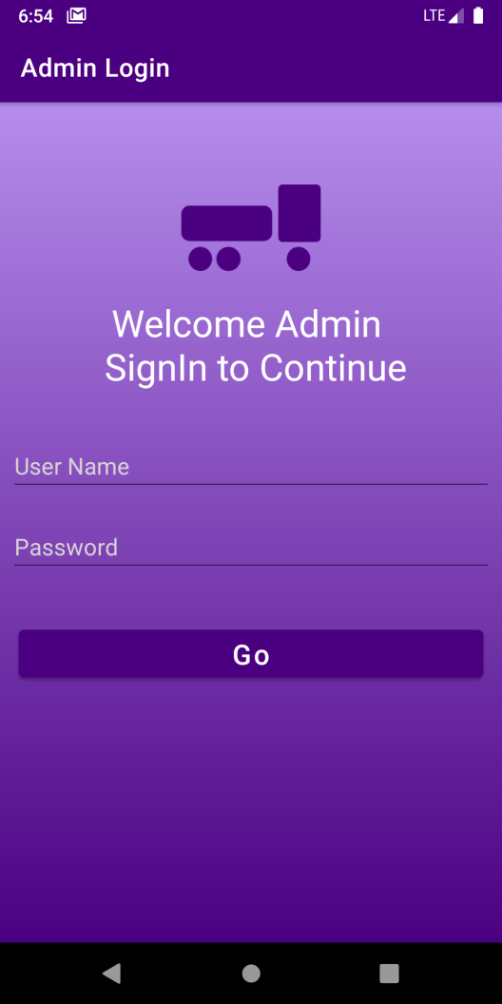
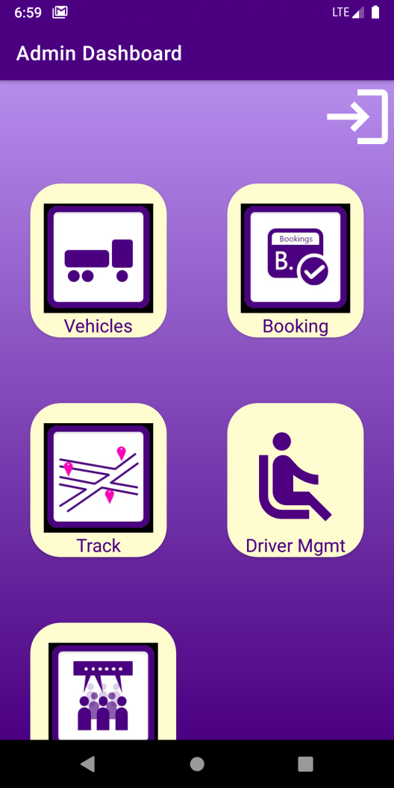
2. Admin
2.1 Admin Login
2.2 Admin Dashboard

Slide 16
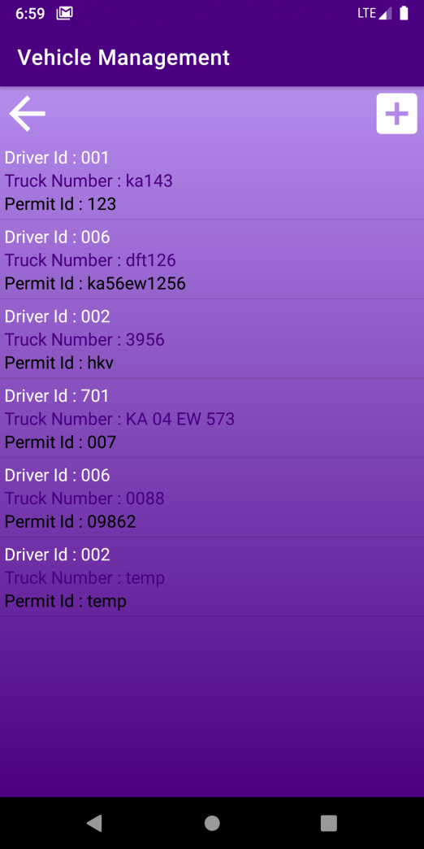
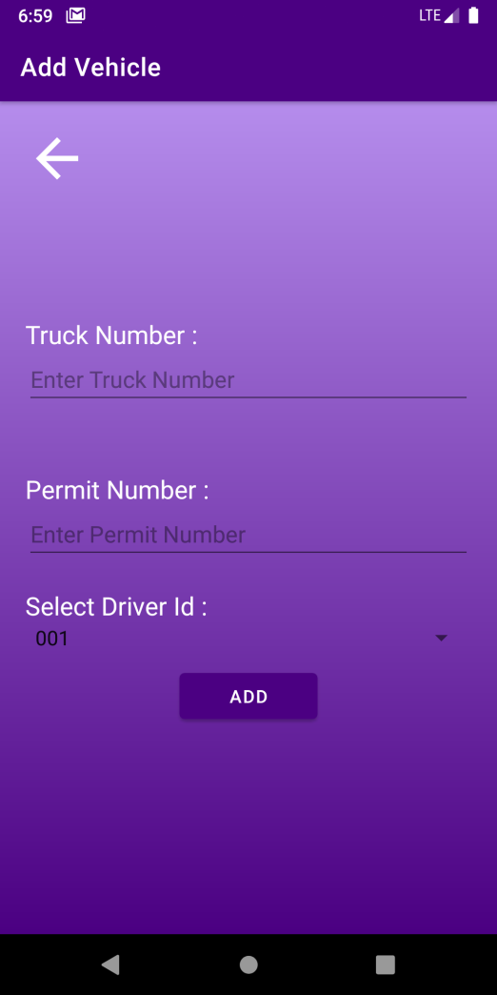
2. Admin
2.2.1 Vehicles
  2.2.1.1 Vehicle Management
  2.2.1.2 Add Vehicle

Slide 17
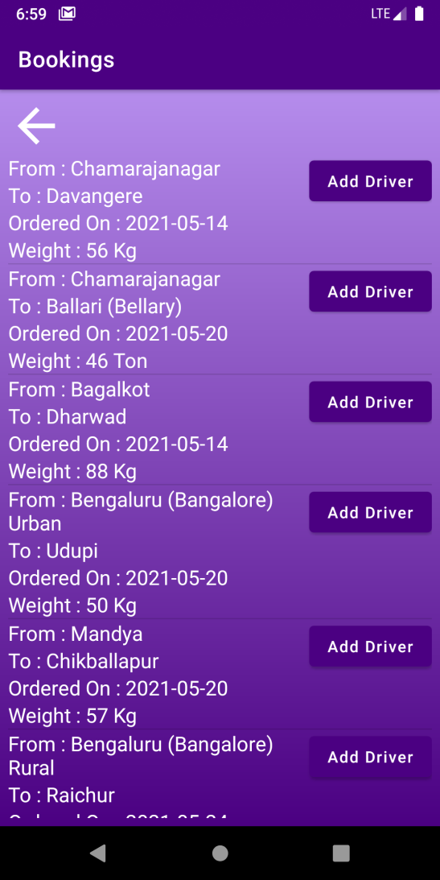
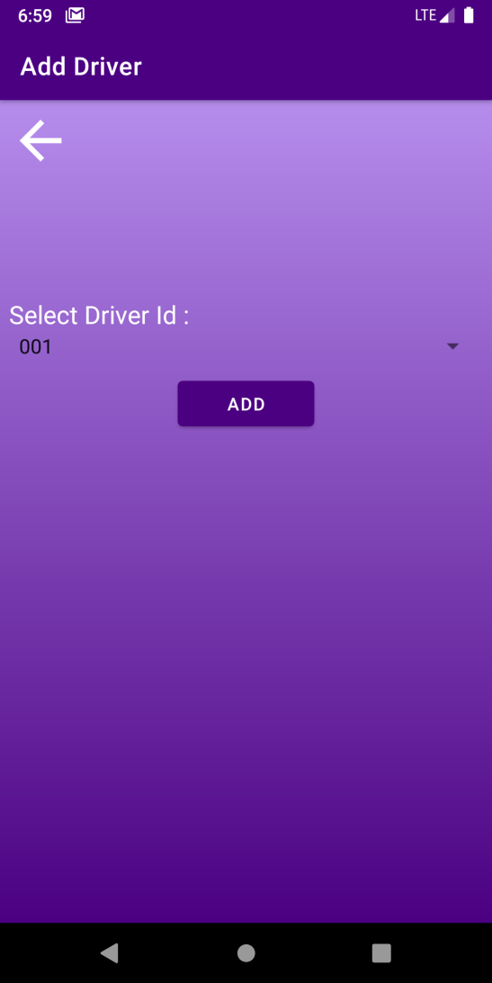
2. Admin
2.2.2 Bookings
  2.2.2.1 Bookings
  2.2.2.2 Add Driver Page

Slide 18
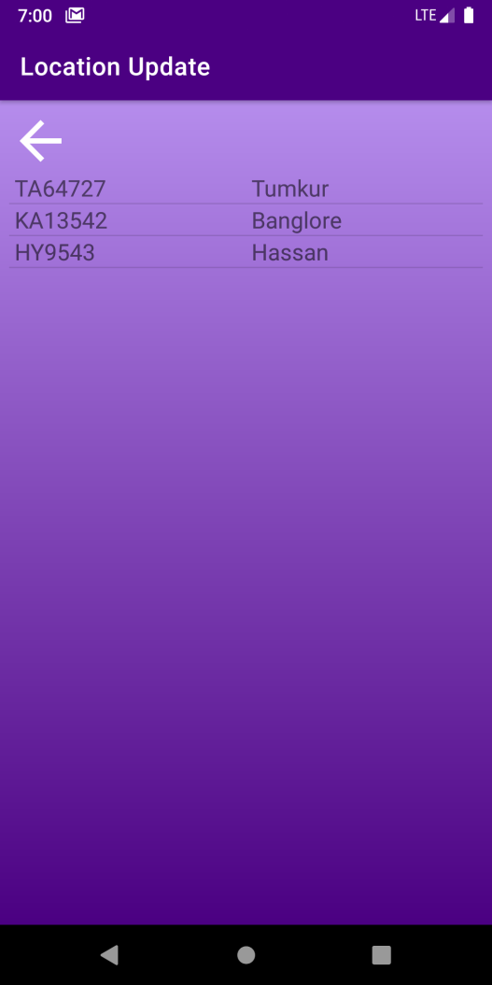
2. Admin
2.2.3 Track
  2.2.3.1Track Page

Slide 19
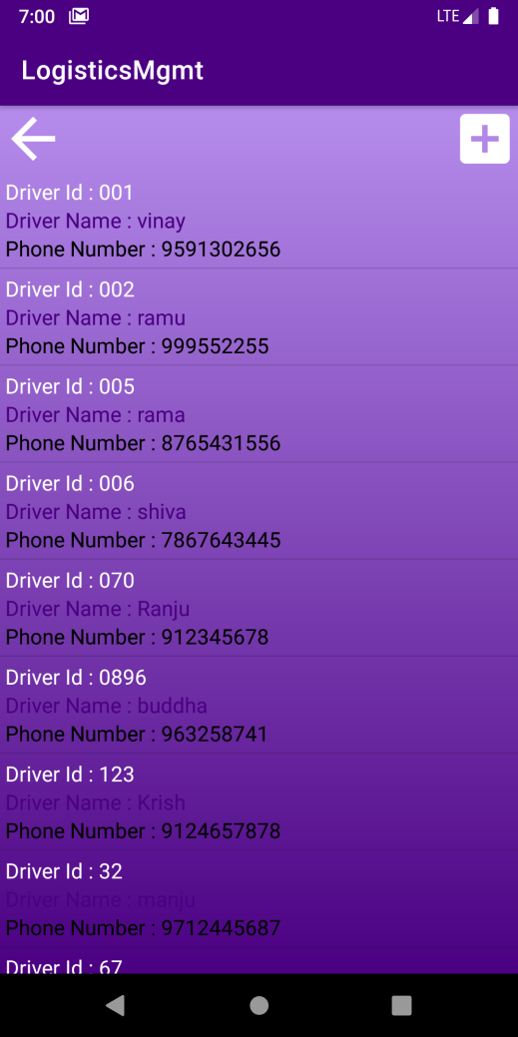
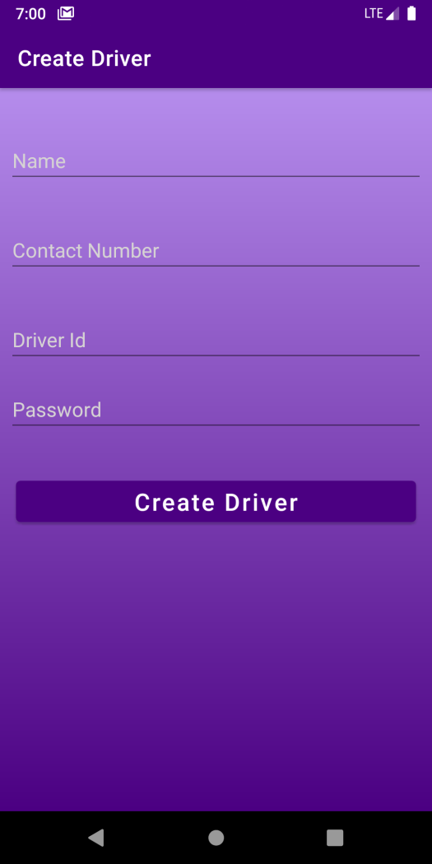
2. Admin
2.2.4 Driver Management
  2.2.4.1 Driver Management
  2.2.4.2 Create Driver

Slide 20
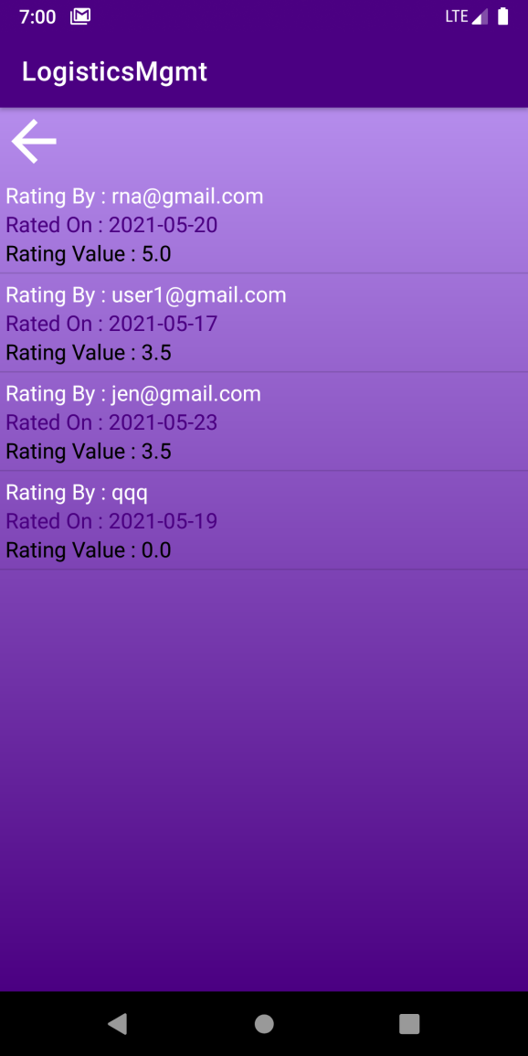
2. Admin
2.2.5 Ratings
  2.2.5.1 Rates and Reviews

Slide 21
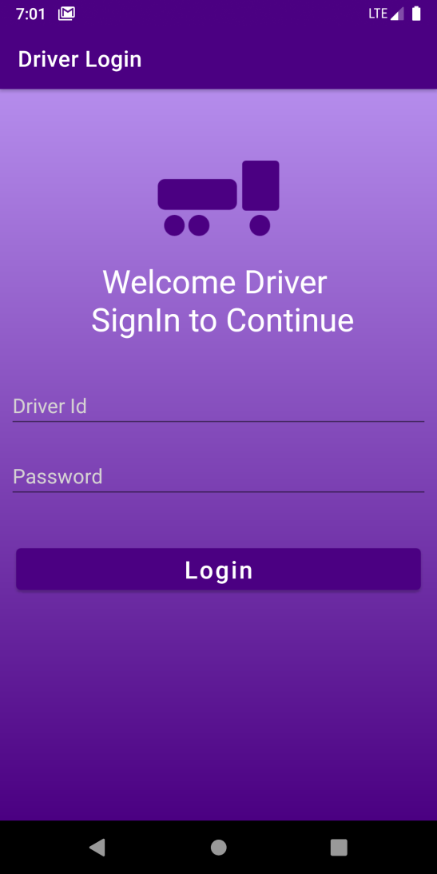
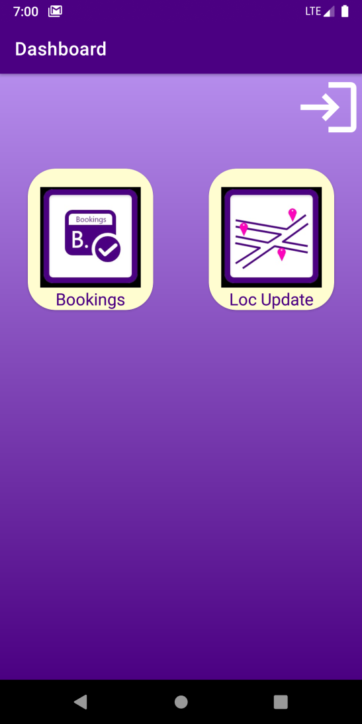
3. Driver
3.1 Driver Login
3.2 Driver Dashboard

Slide 22
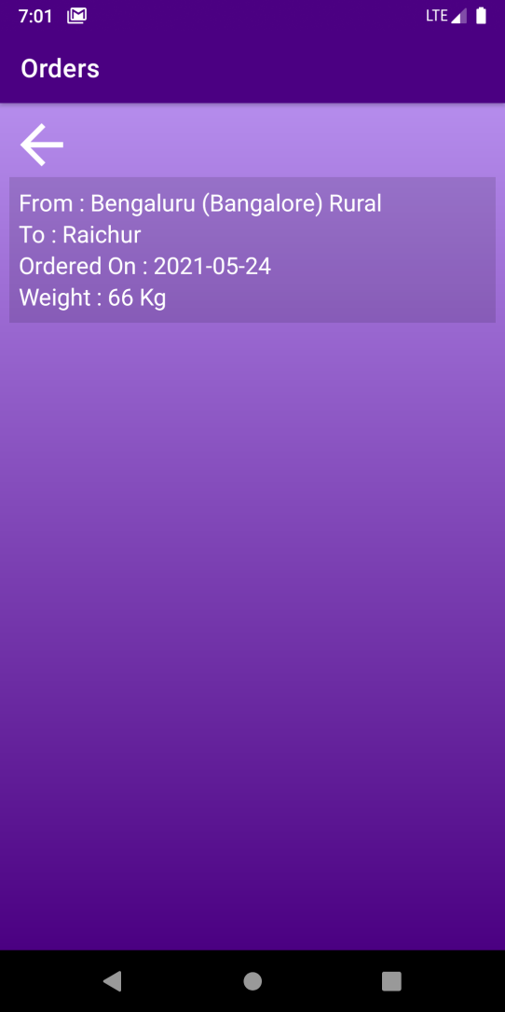
3. Driver
3.2.1 Bookings
  3.3.1.1 Orders

Slide 23
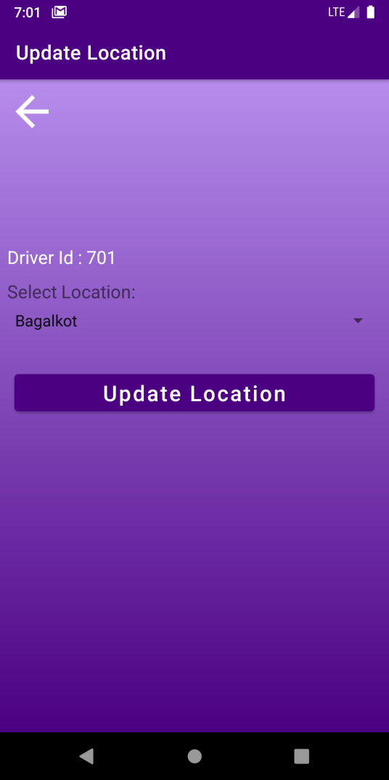
3. Driver
3.2.2 Location
  3.2.2.1 Update Location

Slide 24
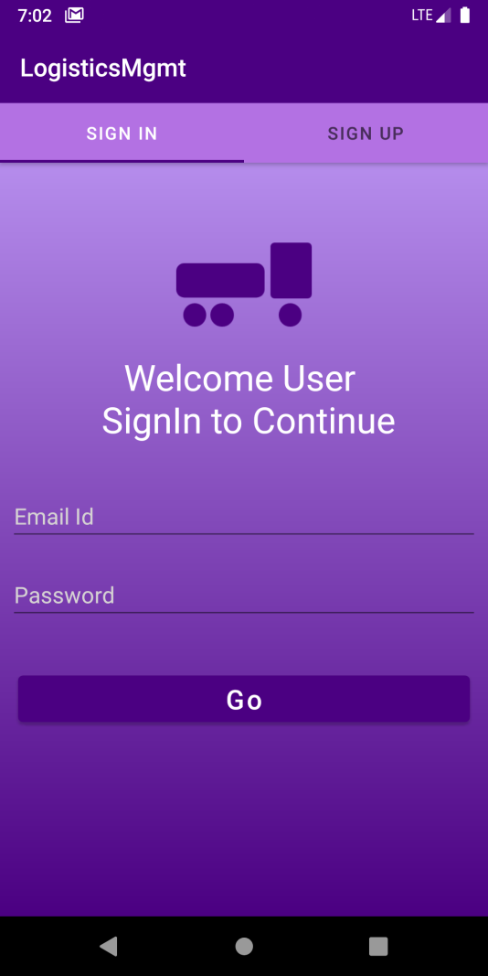
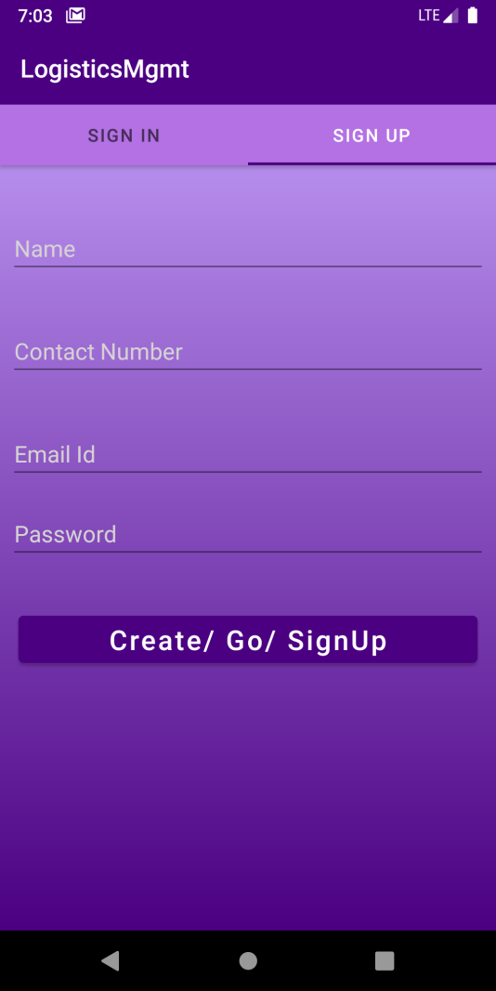
4. Customer
4.1 Customer Login
4.2 Customer Sign-Up

Slide 25
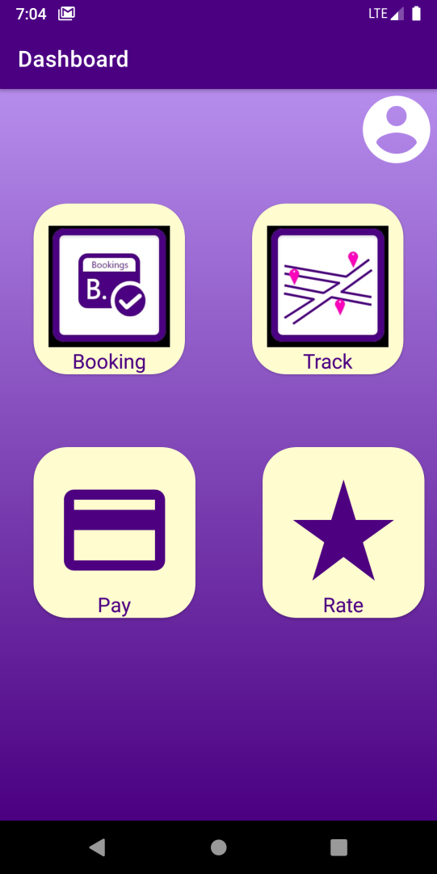
4. Customer
4.3 Customer Dashboard

Slide 26
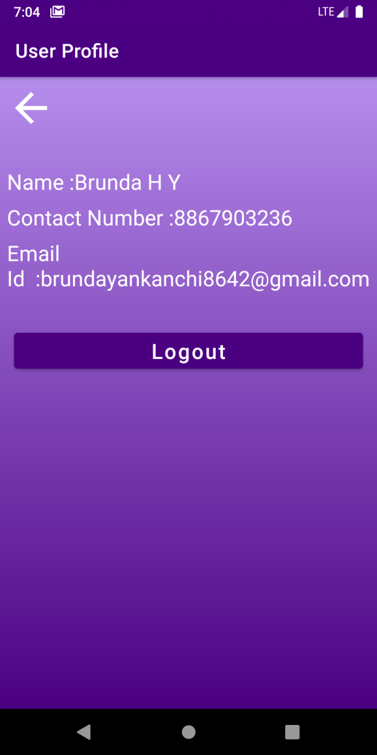
4. Customer
4.3.1 User Profile
  4.3.1.1User Profile Page

Slide 27
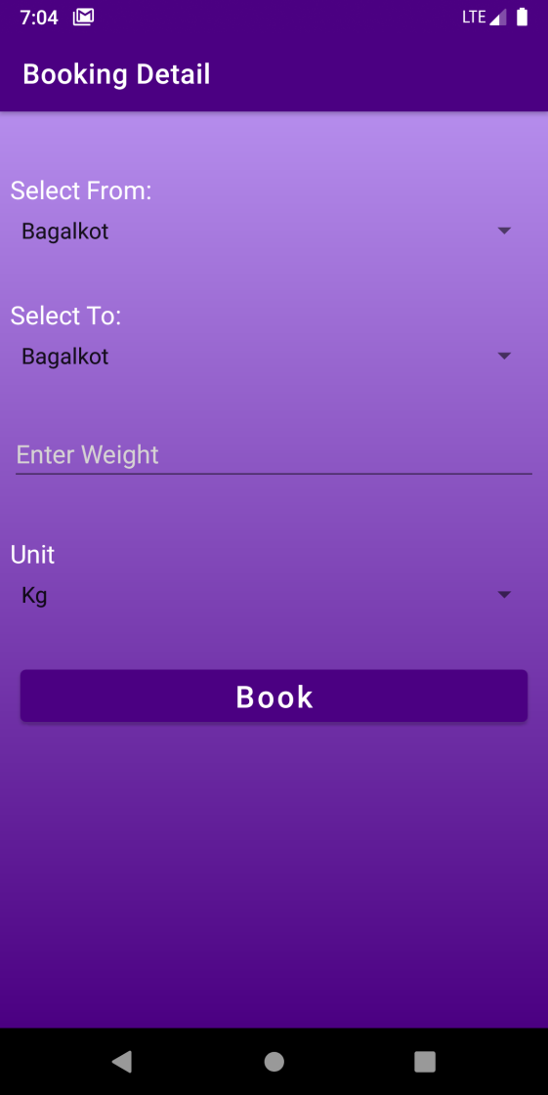
4. Customer
4.3.2Bookings
  4.3.2.1 Booking Details Page

Slide 28
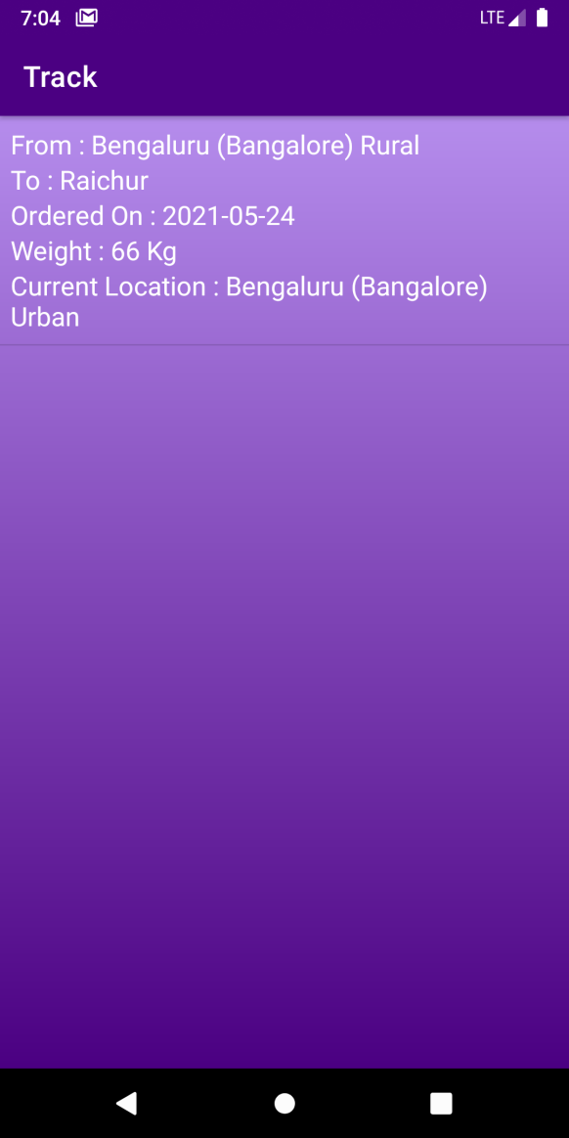
4. Customer
4.3.3 Track
  4.3.3.1 Update Location

Slide 29
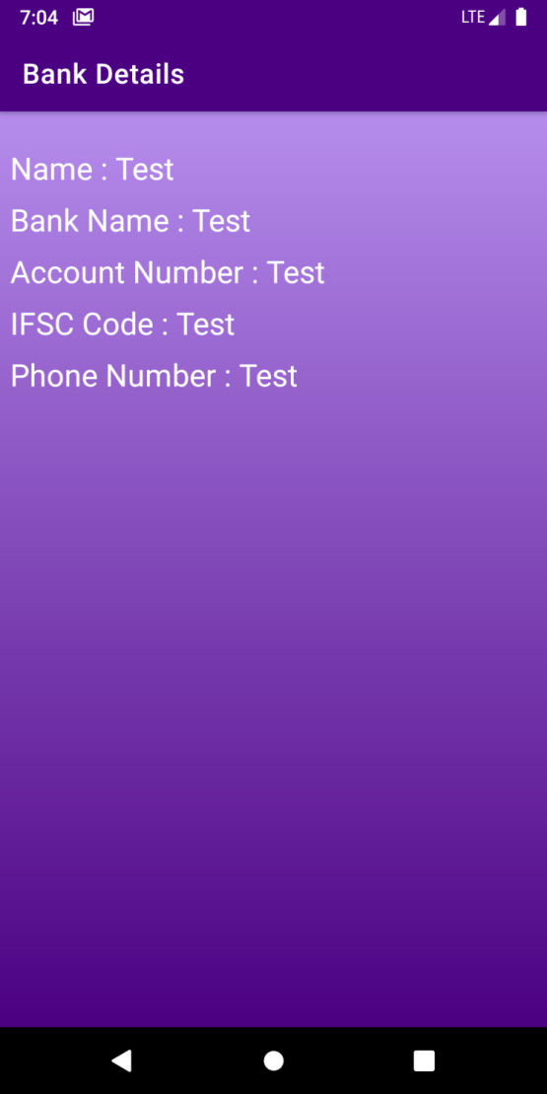
4. Customer
4.3.4 Payment
  4.3.4.1 Bank Details

Slide 30
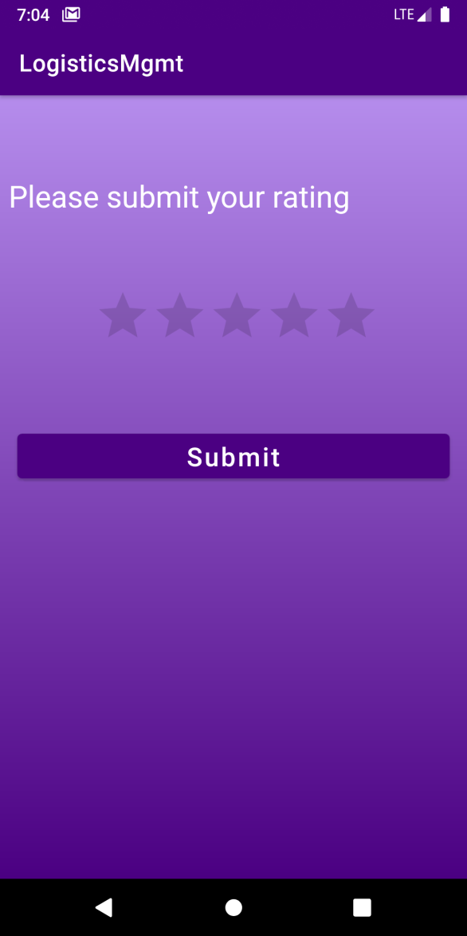
4. Customer
4.3.5 Ratings
  4.3.5.1 Rate and Reviews

Slide 31
Demonstration

Slide 32


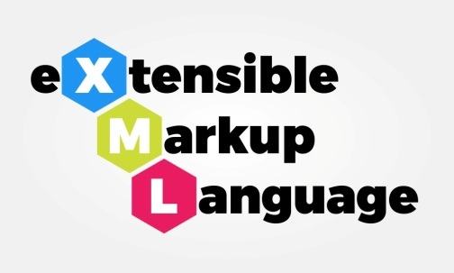
S/W REQUIREMENTS
Software:
  Android Studio
  JAVA Environment
  Firebase Server
  Adobe Xd
Languages:
  JAVA
  XML
  SQL

Slide 33
H/W REQUIREMENTS
8 GB RAM
64-bit Processor
Android with 3 GB RAM

Slide 34
Project Outcome
Logistics management is successfully implemented with the following features:
1. Admin can add trucks, add and assign drivers, view booking, view rating and view updated location.
2. Driver can view the assigned bookings and update the location.
3. User can make bookings, view the updated locations and give ratings accordingly.

Slide 35
Future Scope
Real Time Location Tracking, Authentication, Map Integration, Receipt Generation, and Final Acknowledgement. A full flexible logistics management system can be developed considering this project as basis with the inclusion of following features: Registration, List of Vehicles, Vehicle Booking, Real-time alerts, Payment Gateway, Track Consignment, Book Meetings, Rate and Review, Request management, Shipper details, Route tracking, Driver Monitoring, Billing, Vehicle Management, Schedule Meetings

Slide 36
CONCLUSION
In today’s competitive business environment, getting the correct products to the right place at the right time via the most cost-effective manner is paramount for one’s business’ success. To stay ahead, logistics professionals are using logistics and supply chain mobile applications as must-have tools for operational excellence. Aligning their business with the application will help them keep track of various business activities and increase productivity.
This application helps logistics professionals achieve every business process from tracking inventory and shipments, books meetings with clients, to tracking tasks and projects. By never losing touch with one’s customer, one is able to collaborate as well as better tracking and responding to cases, allowing you to maintain and build stronger customer relationships.

Slide 37
References
[1]Philips, D.M. and Philips, J.K. (1998), “A social network analysis of business
[2]Logistics and transportation”, International Journal of Physical Distribution and Logistics Management.
[3]Prof. Angappa Gunasekaran, “International Journal of Logistics Systems and Management”
[4]Prof. Angappa Gunasekaran, “Developing an E-Logistics System: A Case Study”
[5]Andrzej Szymonik - “Information Technologies in Logistics”
[6]Kersten, Wolfgang (Ed.); Blecker, Thorsten (Ed.); Ringle, Christian M. (Ed.) “Proceedings Digitalization in Supply Chain Management and Logistics: Smart and Digital Solutions for an Industry 4.0 Environment”
[7]Huan Neng Chiu, “The integrated logistics management system: a framework and case study”, National Taiwan Institute of Technology, Taipei, Taiwan, Republic of China.

Slide 38
Thank You

